Slide 1
Circuits Lecture 1: Overview
李宏毅 Hung-yi Lee

Slide 2
Course Information
Time: 09:10 - 10:00 Wednesday and 10:20 - 12:10 Friday
Place: EE BL R112
Text Book: A. Bruce Carlson, ”Circuits: Engineering concepts and analysis of linear electric circuits”, 2005
Grade: 3 out of 4 quizzes [60%], Final [40%], No homework

Slide 3
Scope and dates of the Exams (Temporary )
Quiz 1 (10/22)
Circuit Variables and Laws (1.4, 1.5)
Properties of Resistive Circuits (2.3, 2.4, 2.5)
Applications of Resistive Circuits (3.2)
Systematic Analysis Methods (4.1, 4.2, 4.3)
Quiz 2 (11/12)
Dynamic Circuit (5.3) , Transient response (9.1, 9.3, 9.4)
Quiz 3 (12/24)
AC Circuits (6.1, 6.2, 6.3), AC Power (7.1, 7.2)
Quiz 4 (01/07)
Frequency Response and Filters (11.1, 11.2, 11.4)
Final (01/16)
All above
Laplace Transform Analysis (13.1, 13.2, 13.3)
Two-Port Networks (14.1, 14.2, 14.3)
Notes:
2:00

Slide 4
Instructor
Name: 李宏毅 Hung-yi Lee
Office: EE Building II, R508
E-mail: tlkagkb93901106@gmail.com
Personal Webpage: http://140.112.21.28/~tlkagk/homepage/
Lecture recording, slides and announce of exams will both on ceiba and my personal webpage

Slide 5
Outline
Overview of Circuits
Chapter 1: Circuit Variables and Laws

Slide 6
Outline
Overview of Circuits
Chapter 1: Circuit Variables and Laws

Slide 7
What are we going to learn?
Only one thing
Given a circuit, what are the voltage, current and power consumed for an element?
Have learned in high school?
What is the difference for “Circuits” in university?

Slide 8
What are we going to learn?
1. Complex
Example
(the first quiz)

Slide 9
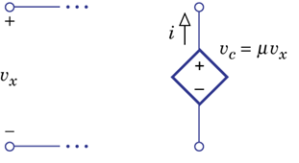
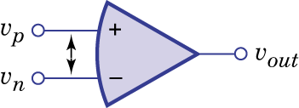
What are we going to learn?
2. Different Kinds of Elements
Resistor
Voltage
Source
or
battery
Controlled Source
Current
Source
Capacitor
Inductor
Operational Amplifier

Slide 10
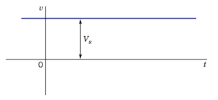
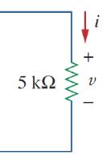
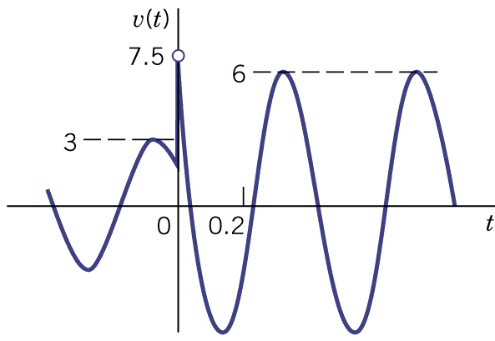
What are we going to learn?
3. Dynamic
High
School
This
Course

Slide 11
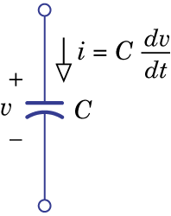
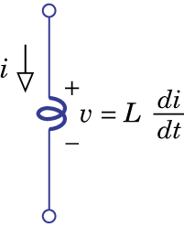
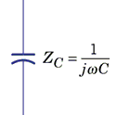
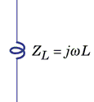
What are we going to learn?
4. New aspects
Consider the circuits from the frequency domain
Time Domain
Frequency Domain
Capacitor and inductor behave like resistor in frequency domain
Notes:
9

Slide 12
Outline
Overview of Circuits
Chapter 1.4, 1.5
Review what you have learned in high school

Slide 13
Outline - Chapter 1
3 Variables: Current, Voltage, Power
2 Elements: Resistor, Source
2 Laws: KVL, KCL
Examples

Slide 14
Outline - Chapter 1
3 Variables: Current, Voltage, Power
2 Elements: Resistor, Source
2 Laws: KVL, KCL
Examples

Slide 15
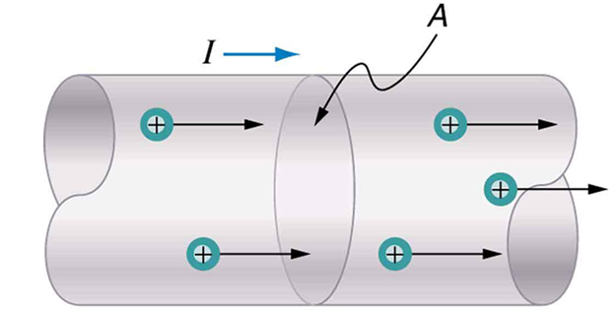
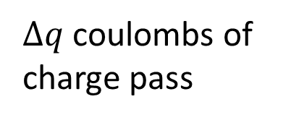
Variable - Current
Current exists whenever charge flows
Current: the flow rate of charge
( Unit: Ampere (A) )
$∆q$ coulombs of charge pass
in $∆t$ seconds
Notes:
Charge (Coulomb, C)
electron: -1.6 x 10⁻¹⁹ C
proton: 1.6 x 10⁻¹⁹ C

Slide 16
Variable - Current
Reference
direction
Actual Current
Actual Current
In this course, current direction is “reference direction”

Slide 17
Variable - Voltage
When a unit charge moves from point A to point B, the energy it lose.
Consumed (absorbed) by the elements on the path
Need two points to define voltage
Absorb$∆w$
A
B
( Unit: Voltage (V) )
+

Slide 18
Variable - Voltage
Potential: Voltage from one point to a reference point
A
A
B
B
C
C

Slide 19
Variable - Voltage
A
Actual High potential
High potential
A
Reference
direction
B
Actual Low potential
A
Actual Low potential
Low potential
B
B
Actual High potential
In this course, voltage direction is “reference direction”

Slide 20
Variable - Power
Consumed Power: The rate of losing energy for charge or the rate of consuming by elements
A
+
-
B
For using the formulation, reference current should flow from “+” to “-”
(Passive polarity convention)

Slide 21
Variable - Power
v or i can be negative
A
+
-
B
Consumed Power p can be negative
Consumed Power = -8W
Supplied power = 8W
Negative consumed power = supplied power
Notes:
13

Slide 22
Outline - Chapter 1
3 Variables: Current, Voltage, Power
2 Elements: Resistor, Source
2 Laws: KVL, KCL
Examples

Slide 23
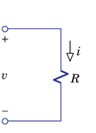
Element - Resistor
Ohm’s Law: The voltage and current are directly proportional to each other.
When using Ohm’s Law, reference current should flow from “+” to “-”

Slide 24
Element – Sources
Voltage
Sources
Current
Sources

Slide 25
Outline - Chapter 1
3 Variables: Current, Voltage, Power
2 Elements: Resistor, Source
2 Laws: KVL, KCL
Examples

Slide 26
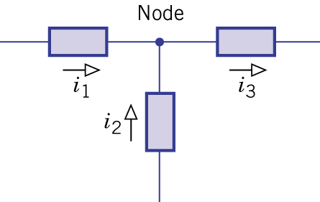
Kirchhoff’s Current Law (KCL)
The sum of the current leaving any node equals the sum of the current entering that node.

Slide 27
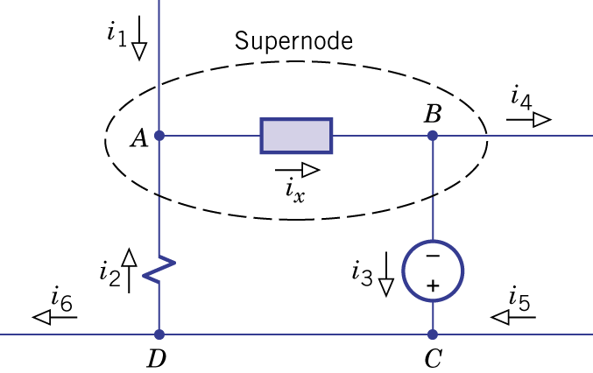
Kirchhoff’s Current Law (KCL)
generalized
bipolar junction transistor (BJT)

Slide 28
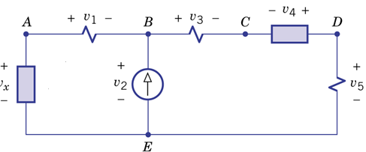
Kirchhoff’s Voltage Law (KVL)
The sum of the voltage drops around any loop equals the sum of the voltage rises.
Loop 1
Loop 2
Loop 3
Loop 1
Loop 2
Loop 3
Notes:
9:00

Slide 29
Outline - Chapter 1
3 Variables: Current, Voltage, Power
2 Elements: Resistor, Source
2 Laws: KVL, KCL
Examples

Slide 30
KVL and KCL – Example 1.9
Find the current and voltage of all elements.
Systematic Solution:
Step 1. List all unknown variables and reference directions
If there are N unknown variables, we need to list N independent equations.
Step 2. Use (a) Element Characteristics, (b) KCL and (c) KVL to list equations for unknown variables

Slide 31
KVL and KCL – Example 1.9
Goal: 7 independent equations
Step 1. Label unknown variables and reference directions
unknown variable:
7 unknown variables, so 7 independent equations

Slide 32
KVL and KCL – Example 1.9
Goal: 7 independent equations
A
B
Step 1. Label unknown variable and reference direction
Step 2 (a) Characteristics of the elements
Step 2 (b) KCL
A:
…… KCL (A)
B:
(dependent to KCL (A) )
Actually, n nodes only provide n-1 independent equations

Slide 33
KVL and KCL – Example 1.9
Goal: 7 independent equations
Loop 3
Loop 1
Loop 2
Step 1. Label unknown variable and reference direction
Step 2 (a) Characteristics of the elements
Step 2 (b) KCL
A:
…… KCL (A)
Step 2 (c) KVL
Loop 1:
…… KVL (1)
Loop 2:
…… KVL (2)
Loop 3:
(dependent to KVL (1) and (2) )

Slide 34
KVL and KCL – Example 1.9
Goal: 7 independent equations
Loop 3
Loop 1
Loop 2
Step 1. Label unknown variable and reference direction
Step 2 (a) Characteristics of the elements
Step 2 (b) KCL
A:
…… KCL (A)
Step 2 (c) KVL
Loop 1:
…… KVL (1)
Loop 2:
…… KVL (2)
For KVL, only consider loop in “hole”

Slide 35
KVL and KCL – Example 1.9
-
-45V
+
Power:
R_{10Ω}: (20V) x (2A) = 40 W consumed
I₁₀: (-45V) x (10A) = -450 W consumed
450 W supplied
Reference current should flow from “+” to “-”
V₂₅: (25V) x (2A) = 50 W consumed

Slide 36
Problem set
In the following lectures, I will select some problems from textbook as homework (不用交)
I know you are busy, so I will not select too much problems as homework.
Read the examples in the textbook
Solve the exercises after the examples
Today’s homework: Find the small error in Example 1.9 (Fig. 1.33)
Be careful about reference direction

Slide 37
Acknowledgement
Let me know if you find any errors in my slides.
I will put your name at the end of the slides.

Slide 38
Thank you!
後天見！

Slide 39
Appendix

Slide 40
Note
Reference direction of current
Reference direction of voltage
Ohm’s Law: $i=\frac{v}{R}$
Reference directions of current and voltage should be associated
Consumed power: p=vi
Reference directions of current and voltage should be associated
Negative consumed power = supplied power

